Slide 1
Object - Relational Mapping
A Brief Overview

Slide 2
What’s the Problem??
OO Systems do objects and associations
Relational Databases do tuples and relations
Some OO concepts don’t fit the relational metaphor
Impedence Mismatch!

Slide 3
What does that mean?
OO Concepts that cause heatburn
Inheritance
Associations w/o domain level foreign keys
Plenty of 1-1 relationships
Traverse objects via relationships
Tuned for domain-knowledge representation

Slide 4
What does that mean?
Relational concepts that don’t match
Joins using duplicate data
Third-Normal Form
The database is the solution to your problems
Stored Procedures
User-Defined Types
Triggers
Tuned for data-access

Slide 5
Not Third-Normal Form
Tournament Winners
Tournament | Year | Winner | Winner Date of Birth
Indiana Invitational | 1998 | Al Fredrickson | 21 July 1975
Cleveland Open | 1999 | Bob Albertson | 28 September 1968
Des Moines Masters | 1999 | Al Fredrickson | 21 July 1975
Indiana Invitational | 1999 | Chip Masterson | 14 March 1977
An example of a 2NF table that fails to meet the requirements of 3NF is:

Slide 6
Third-Normal Form
Tournament Winners
Tournament | Year | Winner
Indiana Invitational | 1998 | Al Fredrickson
Cleveland Open | 1999 | Bob Albertson
Des Moines Masters | 1999 | Al Fredrickson
Indiana Invitational | 1999 | Chip Masterson
Winner Dates of Birth
Winner | Date of Birth
Chip Masterson | 14 March 1977
Al Fredrickson | 21 July 1975
Bob Albertson | 28 September 1968

Slide 7
What can we do?
Understand both sides of the issue
Play to the strengths of both technologies
Stop looking for a silver bullet!!
Realize why you are building the application in the first place
You’re there to solve a business problem, not to build a database

Slide 8
Rule #1
Implement a unique object identifier (or OID) for each object
-- I'm not kidding --

Slide 9
What’s an OID?
A unique identifier for each object instance
NO MEANING - None!!
Totally unique
These will be the keys you’ll use in your database
Am I kidding? See previous slide….

Slide 10
Approaches to OIDs
Use SQL MAX() to generate OIDs for each table
Quick & simple
Only unique within a particular table in a particular DB Instance
Can lead to database hotspots - locality of reference issues
Gives the DB control over part of your object

Slide 11
Approaches to OIDs
Use a centralized OID server
Guarantees uniqueness
Not good for disconnected applications
Creates a possible bottleneck
Can be tough to implement / maintain

Slide 12
Approaches to OIDs
Invent a decentralized scheme that has a low probability of duplication
Can use connected or disconnected
Good random distribution of OIDs
Need to handle possible collisions
Generally easy to implement
MS GUIDs and DEC UUIDs

Slide 13
Approaches to OIDs
Use a hybrid centralized / decentralized scheme
Best of both worlds
No duplication
Good distribution
Tougher to implement

Slide 14
OIDs - A Primer
What should my OID look like?
Integer
Needs to be big
Quick DB access
Tougher for novices to deal with
String
Slower DB Access - Not bad w/ fixed length strings
Composite
Not a good mapping to most DBs

Slide 15
I've got my OID - Now what?
Three tasks to focus on
Mapping attributes to columns
Mapping classes to tables
Mapping associations
There is NOT a “right” way to do this
There are useful patterns to use though

Slide 16
Mapping attributes to columns
An attribute will map to zero or more columns
All attributes do not need to be mapped
Derived attributes
Transient information
Embedded objects
Recursive definition
At some point, attributes will end up in columns

Slide 17
Mapping Classes to Tables
Simplest Case
1 Class = 1 Table
Usually not common
When inheritance is involved
1 table per hierarchy
1 table per concrete class
1 table per class (abstract or concrete)

Slide 18
Mapping Classes to Tables
1 table per hierarchy
Supports polymorphism
Great for ad-hoc reporting
Simple
Lots of wasted space
Lots of headaches to add or change derived classes

Slide 19
Mapping Classes to Tables
1 table per concrete class
Good ad-hoc reporting
Better for changing derived classes
Terrible for changing base classes
Must change multiple tables for each base class change
Medium simplicity

Slide 20
Mapping Classes to Tables
1 table per class
Poor ad-hoc reporting
Very flexible
Good support for polymorphism
High complexity
Slower data access (not terrible, but slower)

Slide 21
Mapping Relationships
Use OIDs as foreign keys
Stick to good data modeling techniques
1-1 Combine in one table if practical
1-M Foreign key in M-side
M-M (No assoc. class) - Build a relation table
M-M (with assoc. class) - Use the assoc class

Slide 22
Concurrency and Locking
Should I lock my objects or let the DB do it?
Optimistic Locking
Let the DB do it
Pessimistic Locking
Think about implementing an object locking scheme

Slide 23
Some tips to use (or ignore)
Logical data models are almost totally useless in an OO application
You don’t need an object database
You DO need a persistence layer
Don’t hard code SQL in your objects
Don’t let the data model drive your class diagram

Slide 24
Some more tips
Even if you have legacy data, don’t let the data model drive your class diagram
Prefer traversal to joins
Don’t use composite keys or keys with business meaning
Stay away from stored procedures
Unless you’re using them to map to legacy data
Don’t get discouraged. This stuff works!

Slide 25
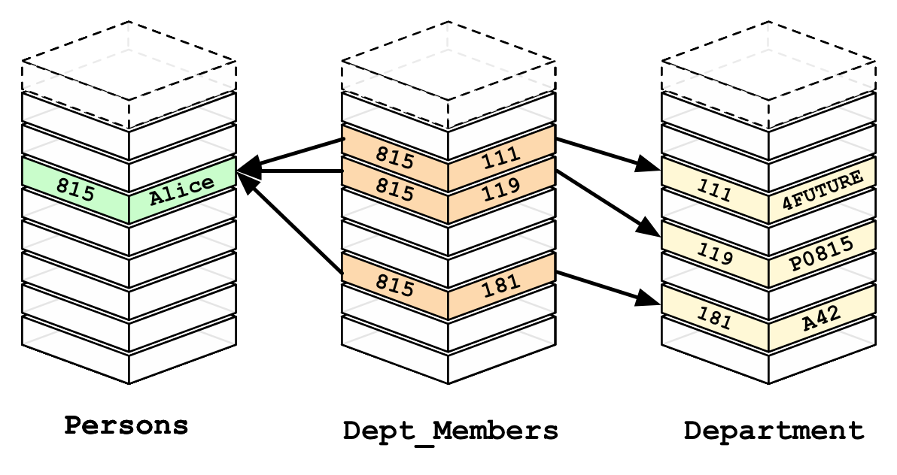
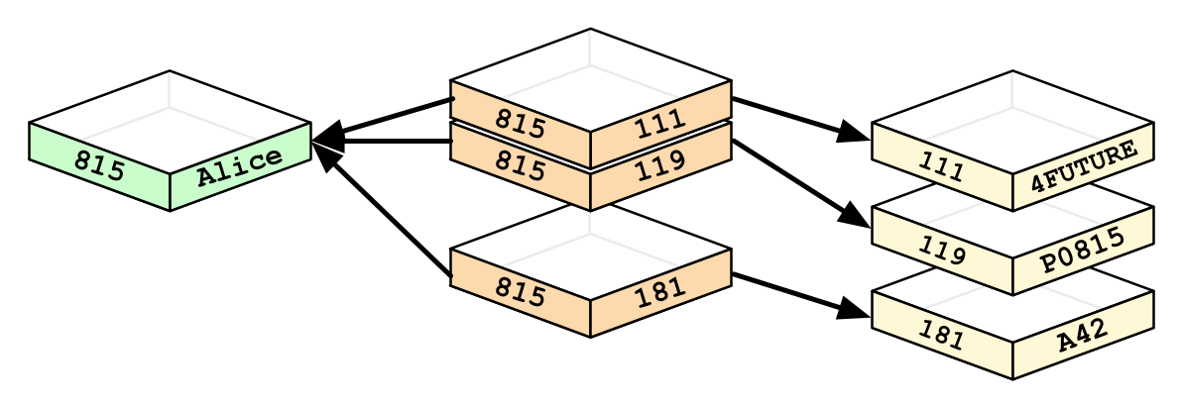

Slide 26
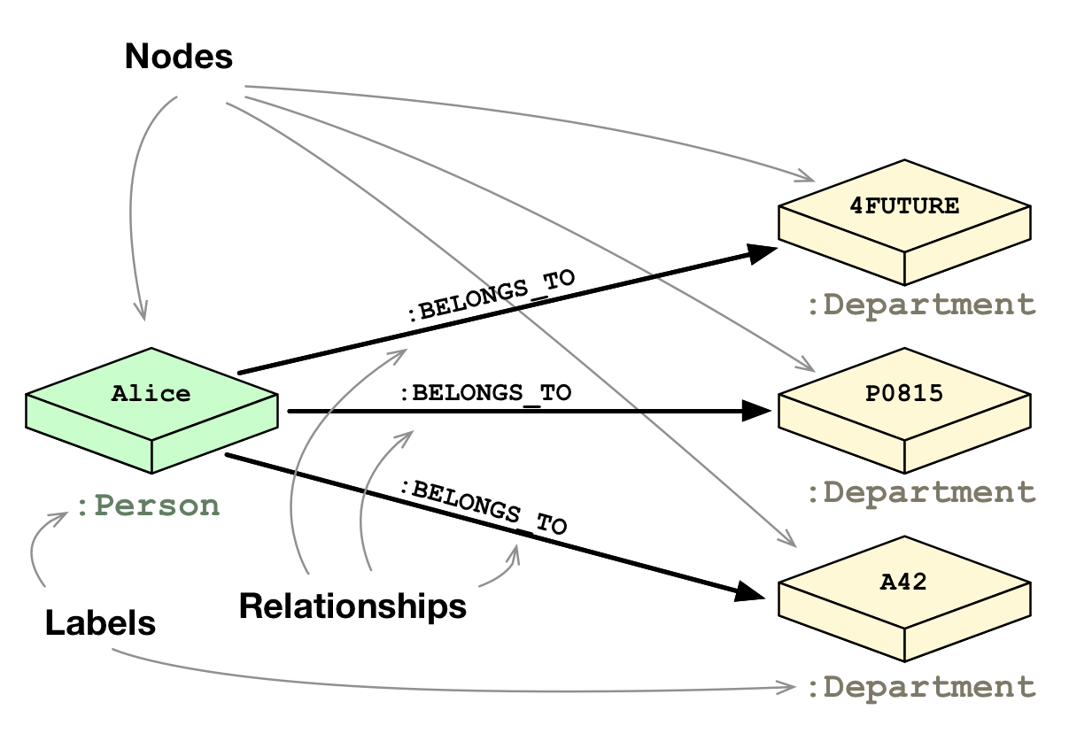

Slide 27
